Slide 1
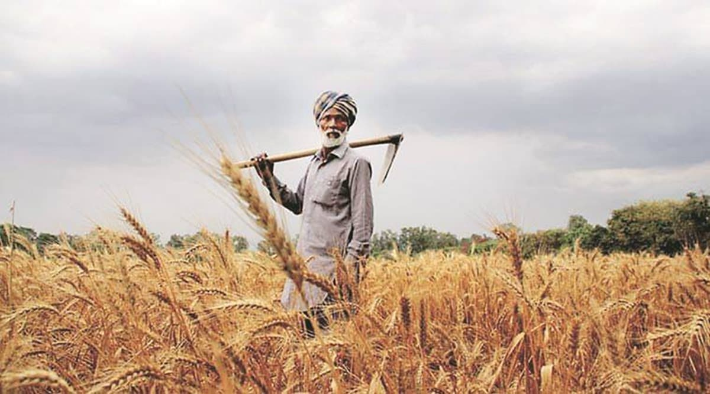
Design Thinking Assignment
Finding solutions for Arjun Verma, the farmer in Haryana
By Thanvir Diouf

Slide 2
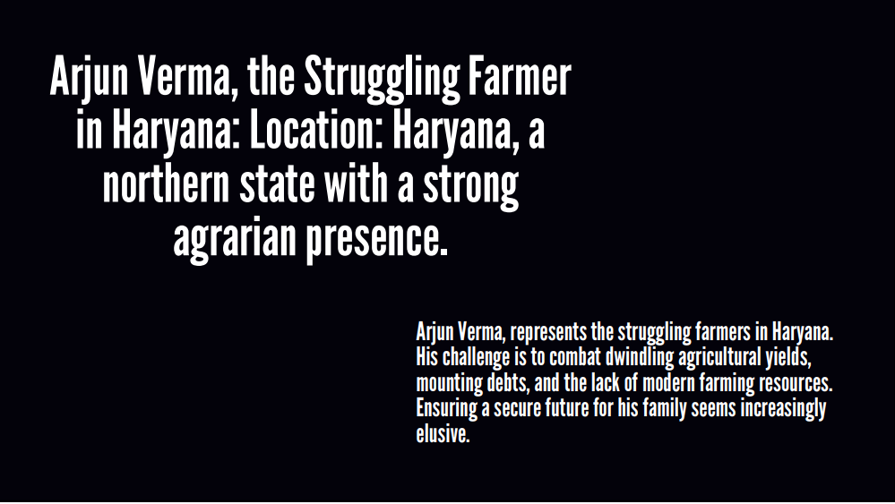

Slide 3
What are the problems they struggle with that you could solve?
Getting higher yield of harvest can be solved by us by giving Arjun access to higher quality seeds and better technology(automated irrigation systems, larger tractors, etc).

Slide 4
What are the aspects of the challenge that you already know a lot about? What are your assumptions?
His challenge is to combat dwindling agricultural yields, mounting debts, and the lack of modern farming resources according to the PPT provided. From this we could assume that he also struggles to provide quality education and improved quality of life.

Slide 5
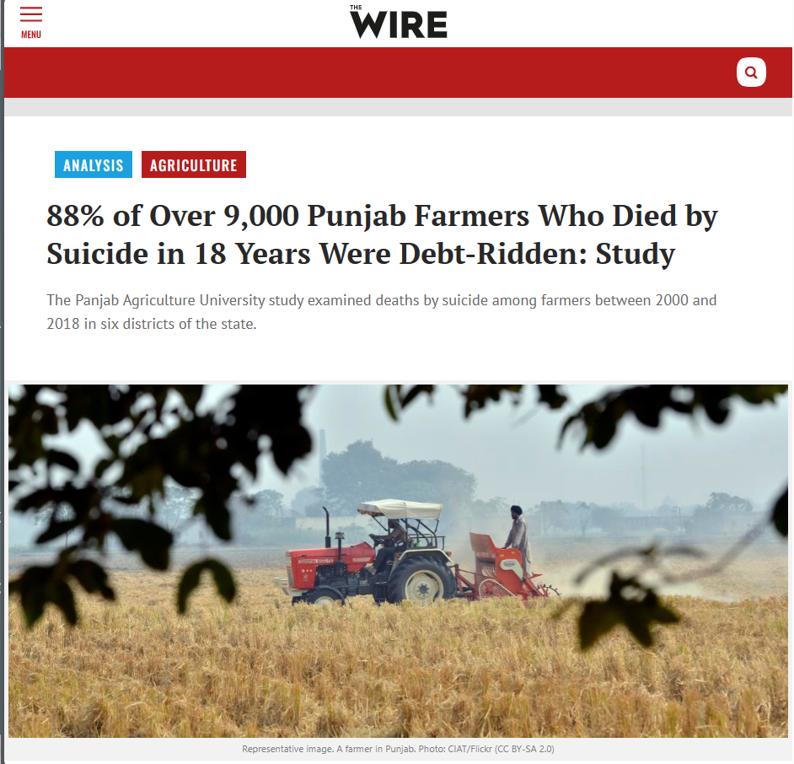

Slide 6
Is there a potential to explore multiple solutions?
The main possible solutions to poverty have to begin at a collective level. Poverty doesn’t happen in a vacuum. It is a product of market forces and government policies. Helping citizens live a life where their basic needs are met is the bare minimum to be expected from your government. We could tell the government to introduce economic safety nets for farmers (For example, if the crops get destroyed due to reasons outside Arjun’s control, the government should provide him his basic needs.)

Slide 7
Detailed solutions:
Crop Diversification:
Explore alternative crops that may be better suited to the local soil and climate conditions.
Consider growing high-value crops or crops in demand in local markets.
Water Management:
Implement efficient irrigation techniques such as drip irrigation to conserve water.
Invest in water-saving technologies and rainwater harvesting.

Slide 8
Soil Health Improvement:
Conduct soil tests to understand soil nutrient levels.
Use organic fertilizers and crop rotation to improve soil fertility.
Modern Farming Techniques:
Stay updated on modern farming practices and technologies.
Consider precision farming methods for optimal resource utilization.
Access to Credit and Subsidies:
Explore government schemes and subsidies available for farmers.
Work with local agricultural banks to access credit for necessary investments.
Cooperative Farming:
Collaborate with other farmers in the region for joint cultivation, resource sharing, and collective bargaining power.

Slide 9
Market Linkages:
Explore direct marketing channels such as farmers' markets or community-supported agriculture (CSA) to increase profits.
Leverage online platforms for selling produce directly to consumers.
Skill Development:
Attend training programs and workshops to enhance farming skills.
Stay informed about new agricultural techniques and best practices.
Livestock Farming:
Integrate livestock into the farming system for additional income sources.
Explore dairy farming, poultry, or animal husbandry based on local demand.
Climate-Resilient Agriculture:
Adapt farming practices to climate change by choosing resilient crop varieties.
Implement water conservation and management strategies to cope with changing weather patterns.

Slide 10
Farm Mechanization:
Invest in modern farming equipment to increase efficiency and reduce labor costs.
Explore the possibility of community-based machinery sharing.
Government Support:
Stay informed about government policies and programs that can benefit farmers.
Advocate for policies that address the specific challenges faced by farmers in the region.

Slide 11
What is your final solution?
Arjun Verma could benefit from government initiatives that provide financial aid and modern farming equipment to struggling farmers.
Collaborative efforts with agricultural experts for sustainable farming practices and access to educational programs can empower him to enhance crop yields. Additionally, community support and awareness can contribute to relieving the burden of mounting debts.

Slide 12
What are the aspects of the design challenge where you need to learn more? What don’t you know?
For this particular problem, I need to consult more poor farmers to get a clearer idea of what problems they face. It’s not that I need to learn the concept of empathy, but I need to explore a larger dataset of struggling farmers to aggregate the problems that they face collectively and to find a root cause for their problems.

Slide 13
What does success look like for you on this project?
Solving the problem of poverty among farmers will be a huge step in improving the morale of the people who feed the country.
Suicides among farmers have been on the rise in the past decade. Reducing farmer suicides will be a big victory in understanding the correlation between mental health and poverty.

Slide 14
My recruits
Aiswarya R: Her resume says that she wants to become successful mentally and emotionally. She might be interested in understanding the emotional state of farmers in distress.
Rasin Shana: Her “Goals” says that she wants to become Prime Minister. This will be helpful to handle to governmental and bureaucratic side of the solutions that we want to come up with.
Ramakurthi Ranjith: His “goals” says he wants to live like a farmer in his 40s. He would be interested in solving this issue as he may himself may benefit from the solutions we find in the future.
Ramdev Narayanan: His “Powers” says that he is a good listener. This is important to collect data from a large number of farmers.
Rushikesh Haregaonkar: His “goals” states that he wishes to start an NGO in a village and spread happiness. His vision seems to align with my project.

Slide 15
THANK YOU

